Slide 1
TDD on TypeScript
Showing off

Slide 2
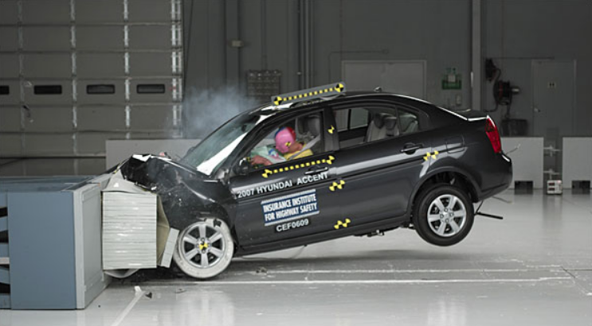
TDD crash course
What is it?
Why do it?
Types
Live coding session

Slide 3
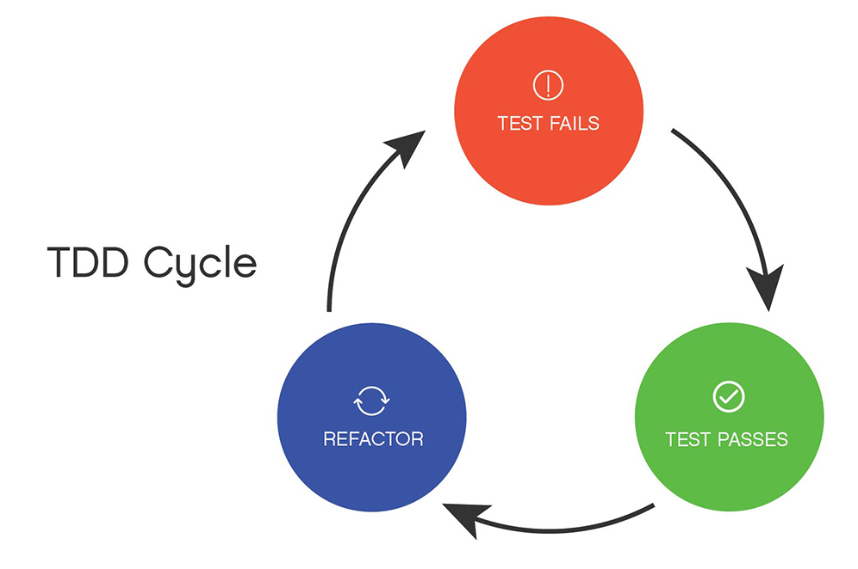
What is it?
Development methodology
Short cycles
Write what you want your code to do (failing test)
Make your code do that in the simplest way possible (make test pass)
Look for patterns and clean up behind (refactor)

Slide 4
At first it’s like this

Slide 5
After a while though…

Slide 6
Why do it?
Testing your code manually is not fun
Debugging takes a lot of time
Machines are faster

Slide 7
Types
Classicist
Explore the problem through tests
Design grows from patterns
Tests are acceptance criteria
Mockist
Define dependencies and responsibilities when writing the tests
Use mocks to keep tests focused on current unit under test

Slide 8
LIVE EXERCISE

Slide 9
THE END

